Slide 1
Transition from Academic to Business life
Dr. Vu Truong Thanh
Senior Manager, Toshiba Asia Pacific PTE. LTD.
Regional General Director, Toshiba Elevator Vietnam Co.

Slide 2
COntents
About myself & my switch from Academy to Business
About Vietnamese Education System & Current hot topics
About my current engineering interest
My favorite research and educational approach: Multi-Discipline

Slide 3
About my-self & Change from academy to business

Slide 4
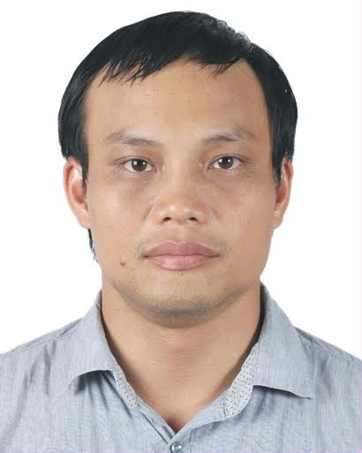
About myself
Education
1994~1999: Undergraduate from Hanoi University of Science and Technology (Vietnam)
Major: Networking and Telecommunications
2002-2011: Master and PhD from Waseda University (Japan) in IT and Networking
Major: Networking and Telecommunications
Full Name: Vu Truong Thanh
DoB: 1976 November 09th (50 yrs old)
Work experience
Researcher (PTIT-Vietnam, 1999-2005)
Research Associate (Waseda University, 2007-2010)
Lecturer on Communications Topics (Post and Telecommunications Institute of Technology -Vietnam, 2012-2015)
System Integrator/ICT management consultant (2012-2015)
Senior Manager @ Hanoi Rep. office (Sept 2015~Now: 10 yrs)

Slide 5
My transition from academic to business world
Teaching/Researching
~2015
Consultant
(2012~2015)
Business
(2015~)
Communications topics
System integration for large ICT systems
- Development of Infrastructure Business for a Japanese Group

Slide 6
My transition from academic to business world
Why:
Fun fact: Teacher salary in Vietnam is rather low (~400USD/month @ 2015)
Can complement income by doing project research or consultant
I prefer solving real world issues so I choose to be consultant -> too time consuming
Advantage for someone with academy background
Having systematic research approach from academy, are more time consuming when solving problems in real business world, but help to provide a more thorough solutions with credible test cases
If I return to the teaching career in the future, I can give better carrier advices to students

Slide 7
About Vietnamese Education System & Current hot topics

Slide 8
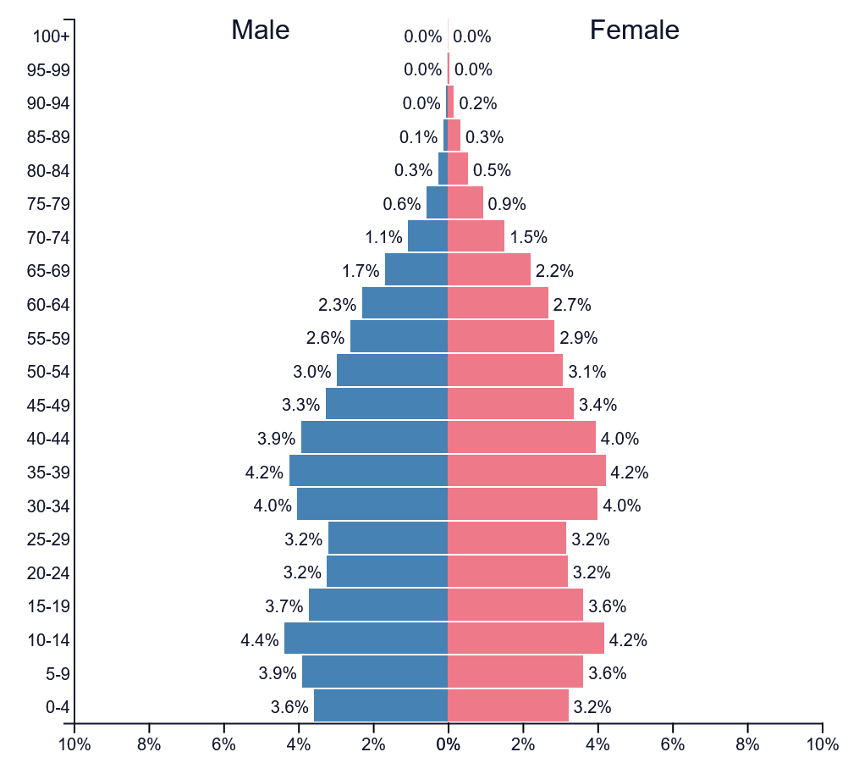
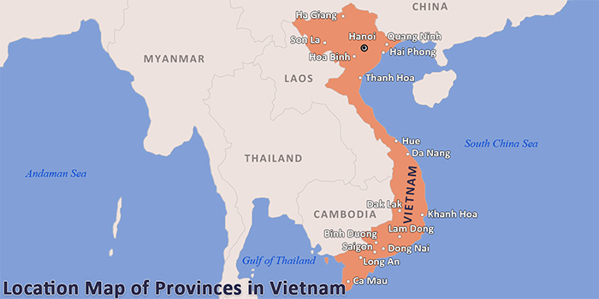
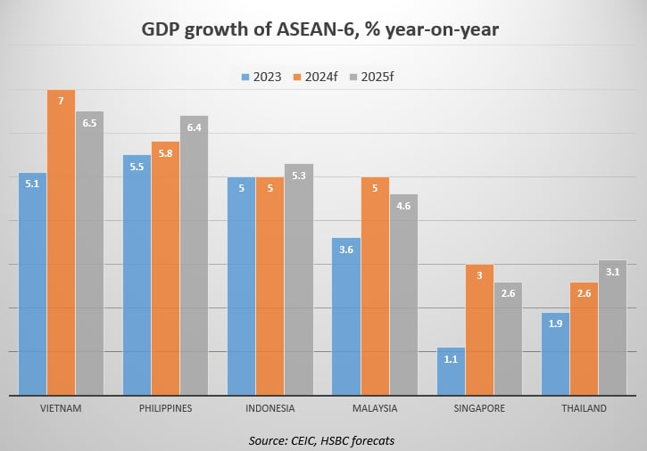
Vietnam AT A glance
Population: 101 mil., golden pyramid
Area: 331,000 km²
GDP/person: 4800USD
Fast growing economy based on FDI (low skill cheap labor) → moving toward hightech and
science

Slide 9
Vietnam education system
12 years of general education
5 years of elementary (compulsory)
4 years of secondary (compulsory)
3 years of high school
Undergraduate
4 years for bachelor
4.5~5 years for engineering
6 years for medicine
Higher education are similar to other countries

Slide 10
Main characteristics of Vietnamese education system
Parents have high expectation of kids, would push kids hard to excel in school
Heavy on knowledge, less on critical thinking
Some remnants from the Soviet system mixing with result-based East Asia style
Lots of homework, tutoring school
pupils have to do model problems over and over again in order to memorize how to solve a specific problem with will come up in the final examinations
Undergraduate courses are reducing textbook teaching, adding more project-research time
Before: re-training after enter the workforce
Now: more readiness to perform on job

Slide 11
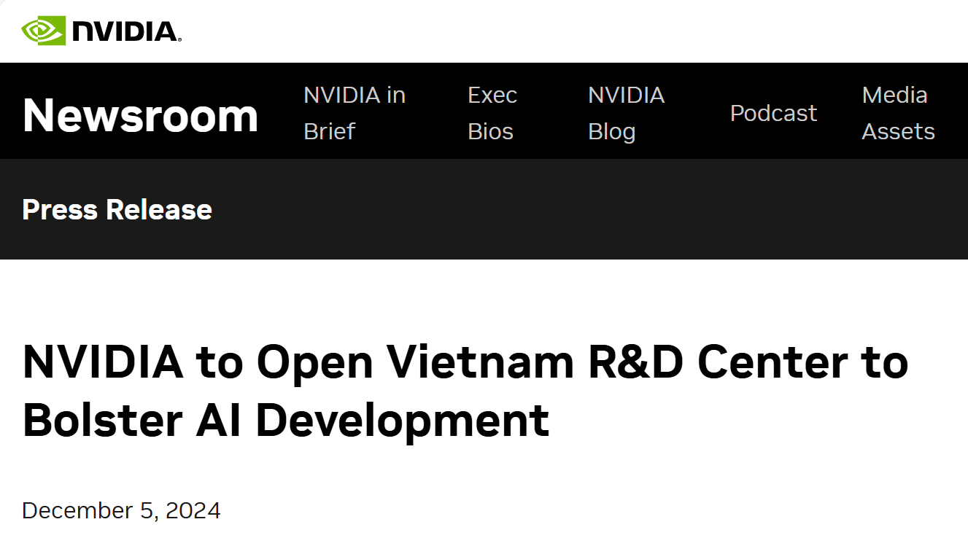
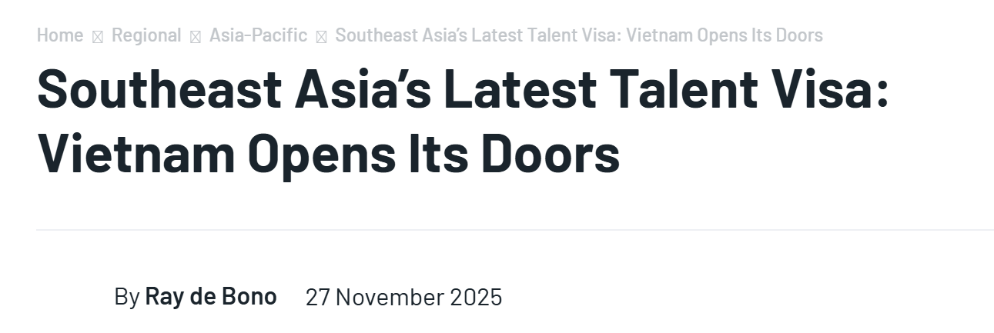
Hot EDUCATION and research topics
Five major areas
Semiconductors
artificial intelligences
mart factories
smart cities
digital technologies
HR Development Target:
Training 50,000 semiconductor professionals
5,000 AI specialists by 2030
Establishing key research laboratories

Slide 12
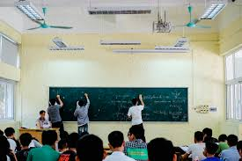
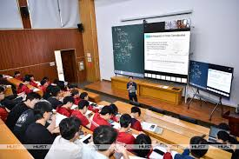
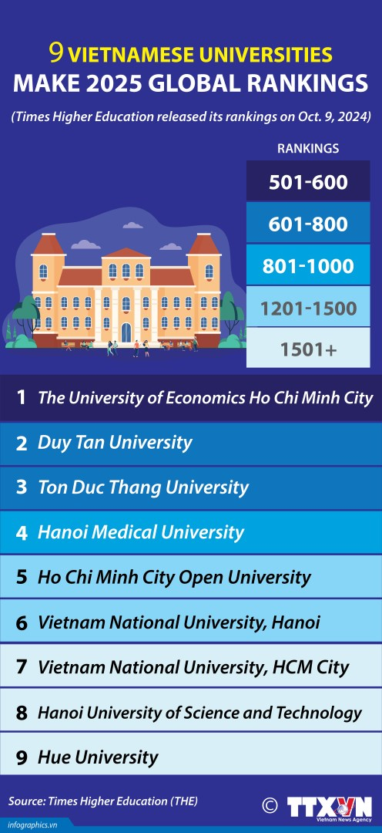
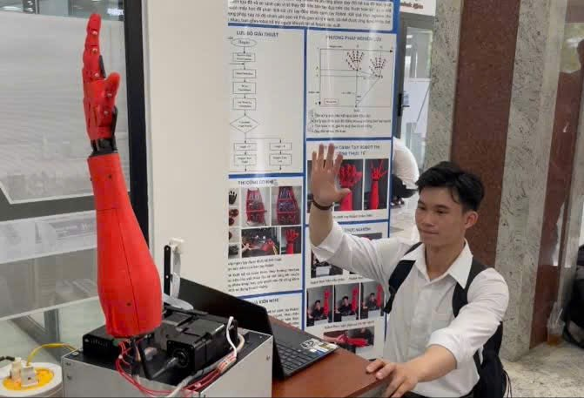
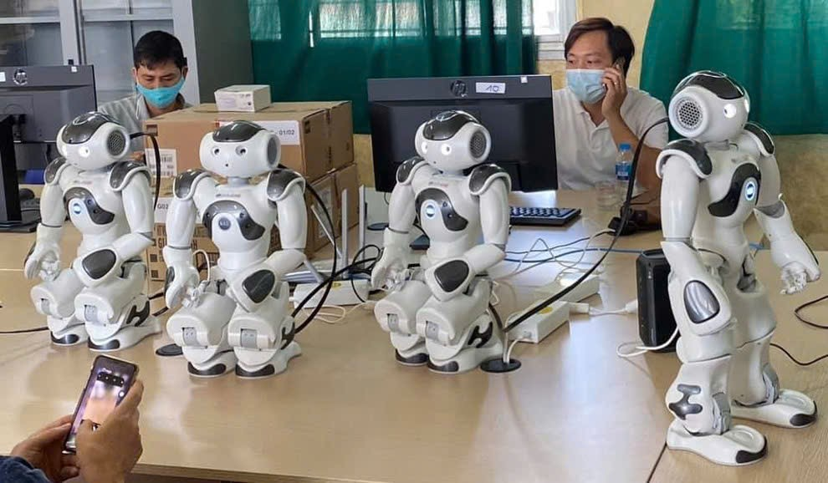

Slide 13
About my current engineering interest

Slide 14
Battery Energy Storage System using recycled batteries
Revive/rejuvenate lead-based and Lithium based batteries
Multi loop Multi-stage charging
Smart battery management unit
Combined with Revive/rejuvenate function

Slide 15
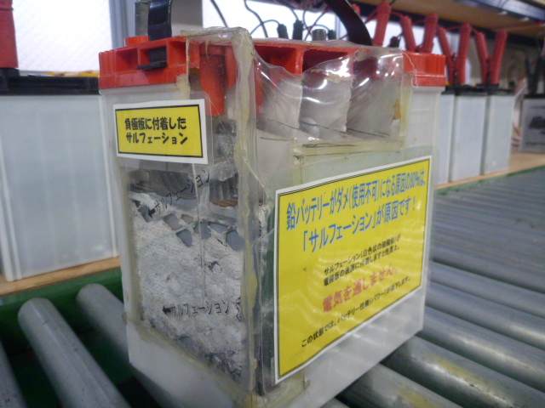
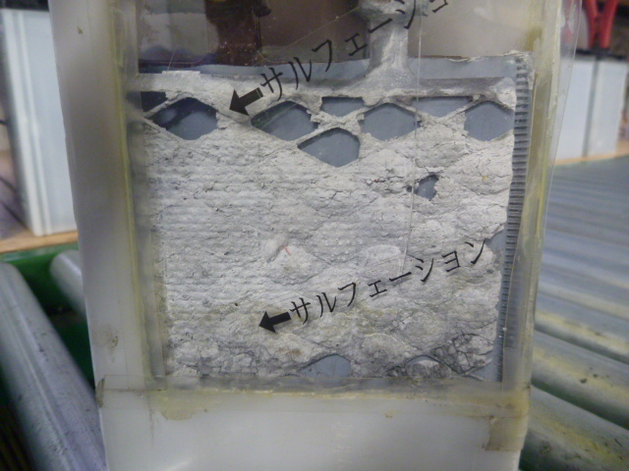
Issues with LEAD ACID Batteries
SULFATION
CELL UNBALANCE
AGING OF ELECTRODE
Solutions
Using chemical to remove sulfation ⇒ cannot solve Cell unbalance
Using high power pulse to remove sulfation ⇒ unreliable, cannot
solve Cell unbalance

Slide 16
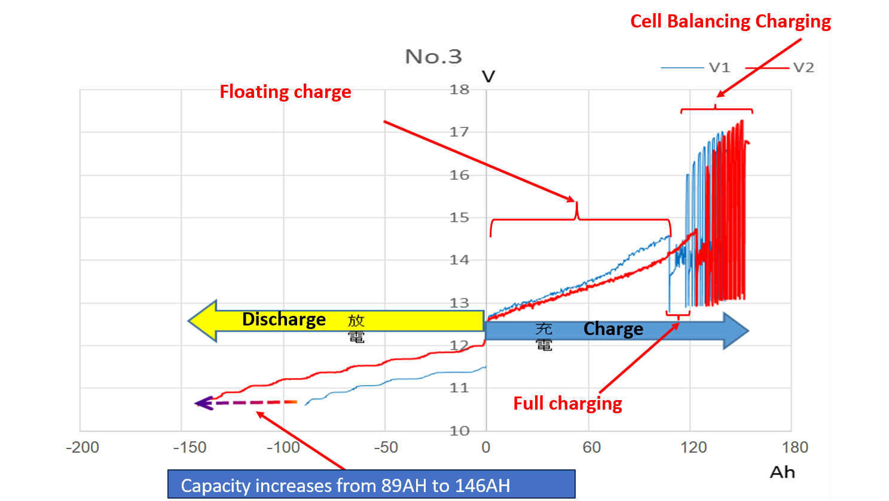
Multi loop Multi-stage charging

Slide 17
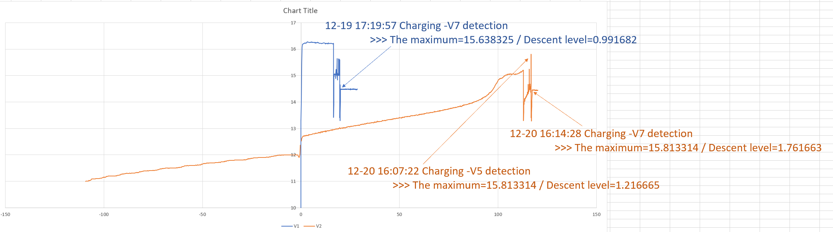
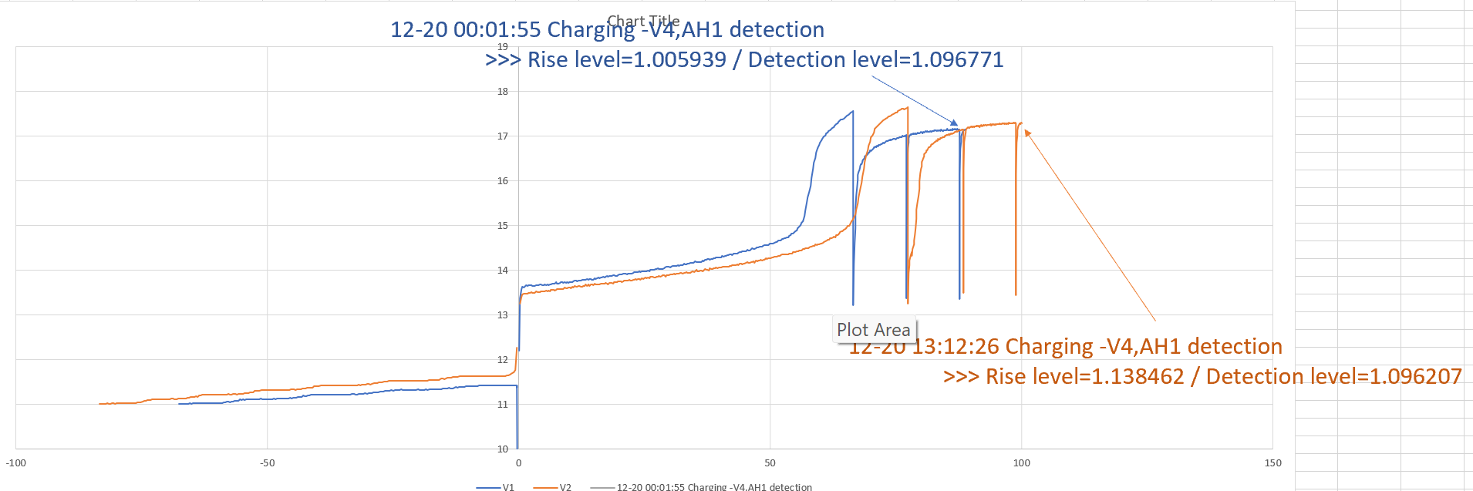
Why more effective: Detecting abnormality

Slide 18
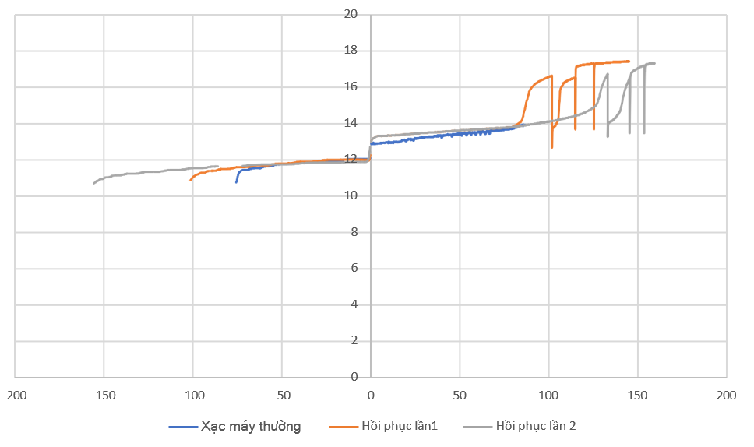
Typical result

Slide 19
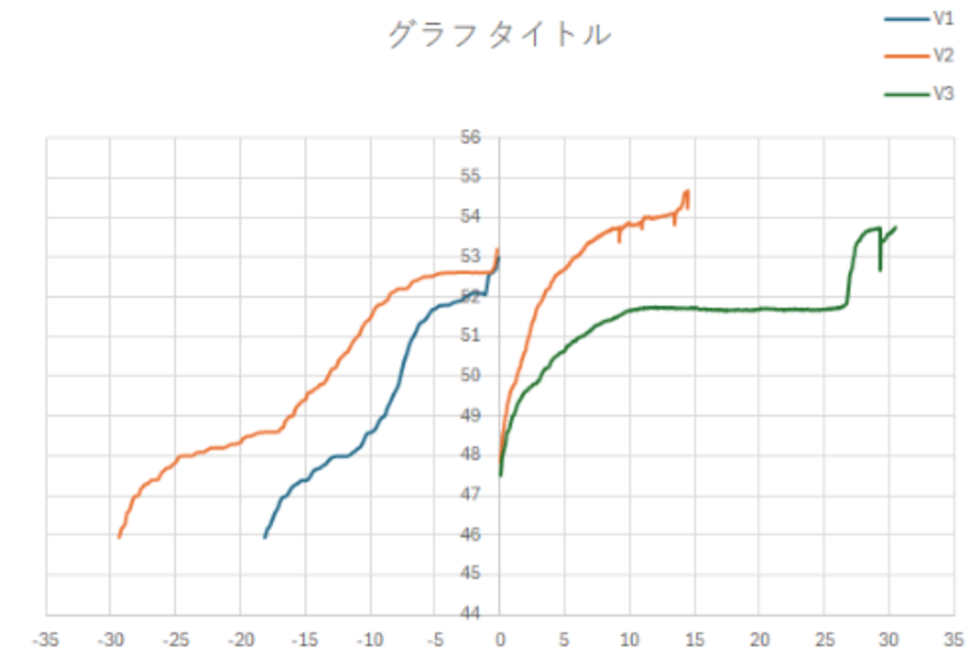
TRIAL with LITHIUM BATTERY

Slide 20
My favorite research and educational approach: Multi-Discipline

Slide 21
My favorite educational approach: Multi discipline
Multi discipline approach
Combine knowledges/skills on several areas to invent/develop a useful solution
Anything you know will become useful at some stage
Will be more suitable if you are planning to work on real world problems/industry, but can be helpful in theoretical academic research as well
Example: development of blue-light LED

Slide 22
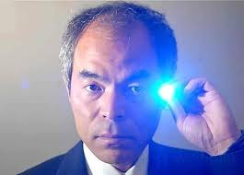
The case for multi discipline: Blue light LED
1962: First visible light LED
1968: the red light LEDs became practical and commercially viable
1970s: commercially viable green LED was created
1972: blue light LED initially discovered (very low brightness)
1993: Shuji Nakamura from Japan produce blue light LED that is bright enough for lighting purpose

Slide 23
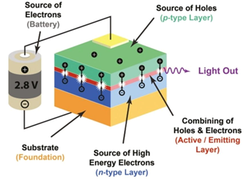
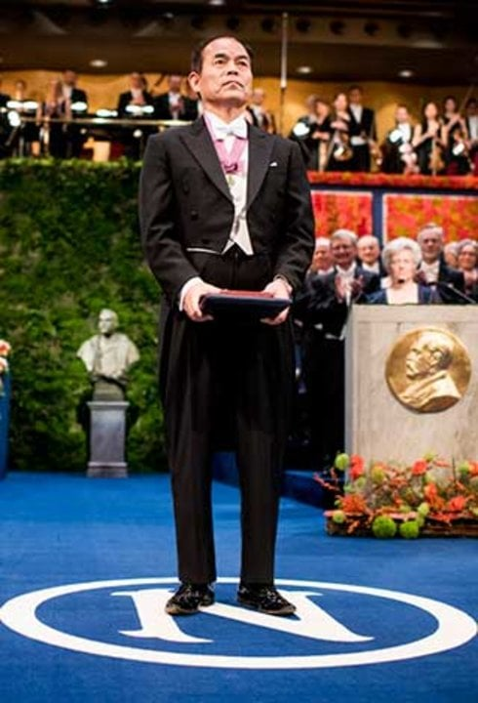
Research on blue light first as an engineer, then to get his PhD
Work with Metal Organic Chemical Vapor Deposition (MOCVD) reactor to create mass, clean crystal in U.S in 12 months, enough to tweak the machine to his needs
At the time, there are two crystal candidates for making Zinc Selenide and Gallium Nitride, Mr. Nakamura chose Gallium Nitride because it was the less preferred medium, which gave more chances for new results (for his PhD)
Due to his fluent uses of MOCVD reactor, he can tweak the reactor to create the necessary crystal to make the blue light LED
He won the 2014 Nobel Prize for Blue Light Invention

Slide 24
AI: challenge and opportunity for multi discipline approach
Challenge: competing with machine is not easy
Opportunity: it used to cause a lot of time to acquire a sufficient level for a skill, especially in ICT field ⇒ Now you can learn the basics and learn how to use AI to do it professionally

Slide 25
Thank you
Q&A

